Slide 1
Data formats and formatting data: PAR/REC, dicom, BIDS, …
April 5, 2023

Slide 2
Data Formats

Slide 3
PAR/REC
PAR=parameter
Includes all the header information
REC=records?
Includes the imaging data
Convert to .nii using dcm2niix
Note: depending on the version, dcm2niix may or may not scale the images correctly
For conventional images, the intensity should be in the 10⁶ rather than 10³
Only really matters if combining data from different sequences

Slide 4
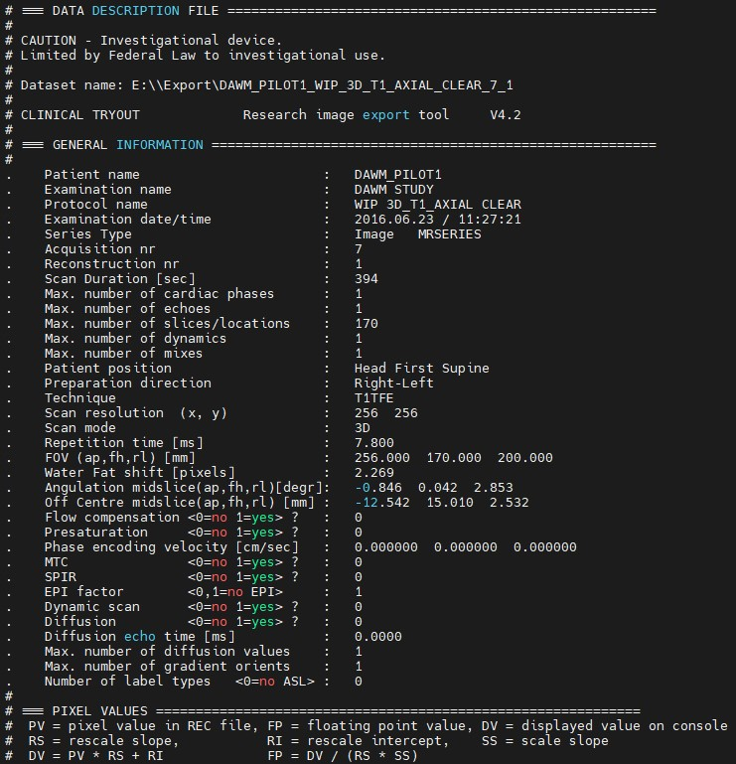
Example PAR file

Slide 5
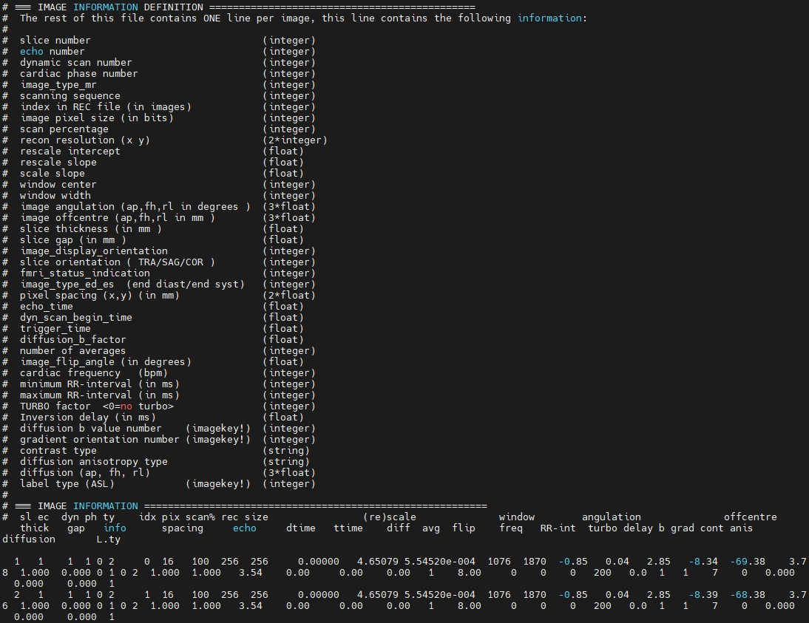
Example PAR file

Slide 6
GE Raw files

Slide 7
DICOM
Stands for Digital Imaging and Communications in Medicine
Supposed to be a universal file format
Each vendor is slightly different
Odd numbered tags can be vendor specific
Comes in classic and enhanced versions

Slide 8
Reading Dicoms
Images just saved as a large list
On philips, data saved in chunks of 2048 files
On GE, data saved all together in one directory
Enhanced dicom generally just makes one file
To see header in matlab: dicominfo
Many other programs available
Convert to .nii using dcm2niix
Note that version number can be important as features keep changing
Also note that the json file does not capture all header info (e.g. scan date)

Slide 9
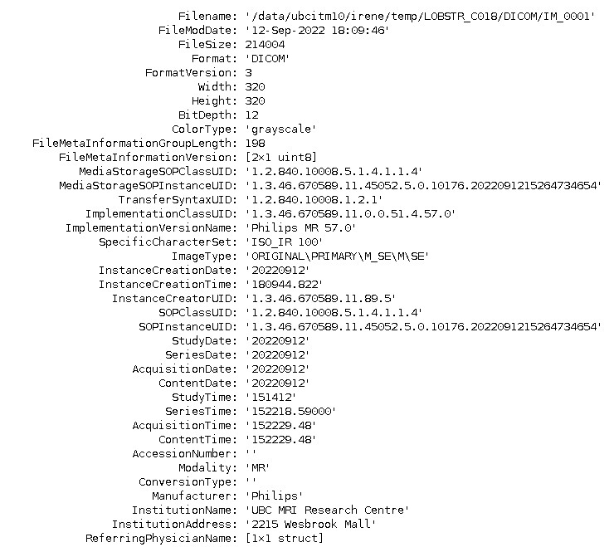
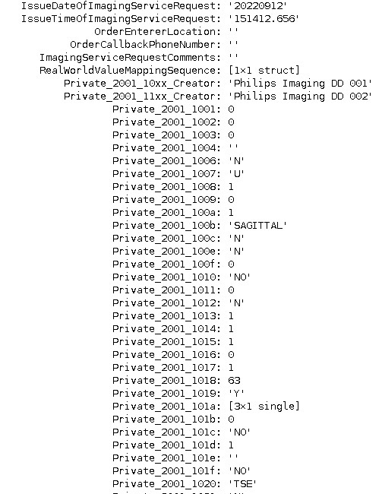
Example Dicom Header

Slide 10
NIFTI
Used by many applications and scripts
Not usually a raw data format off scanner
Convert to .nii using dcm2niix
Lose some header info after conversion
Note that it’s usually saved in .gz format
Some applications (e.g. matlab) do not deal with this well

Slide 11
ISMRM Raw Data Format
The ISMRM Raw Data (ISMRMRD) format is proposed as a common MR raw data format to facilitate the sharing of data and data processing tools.
It is composed of the data fields required to reconstruct images from magnetic resonance experiments.
C/C++, Python and MatLab application interfaces have been developed to translate MR data from the different MR vendors into this open data format.

Slide 12
ISMRMRD
The data is stored in HDF5 format combining a mix of flexible and fixed data structures in the next way:
A flexible document that can contain an arbitrary number of fields in an XML format. This document stores parameters that are specific to the experiment.
A raw data section that holds the data acquired from the experiment.
Additional post-processed data, such as reconstructed images and coil sensitivity maps, can be stored in the HDF5 header.
Reference: Inati SJ, Naegele JD, Zwart NR, Roopchansingh V, Lizak MJ, Hansen DC, Liu CY, Atkinson D, Kellman P, Kozerke S, Xue H. ISMRM Raw data format: A proposed standard for MRI raw datasets. Magnetic Resonance in Medicine. 2016 Jan 1.

Slide 13
Formatting data

Slide 14
What is BIDS
BIDS (Brain Imaging Data Structure) is a standardized format for organizing and describing neuroimaging datasets to promote re-use of both data and code
BIDS defines a specific directory structure and a precise file naming schema

Slide 15
MRI data in BIDS
MRI data stored in the NifTI format
Paired with a JSON sidecar file
Extra .json and .tsv files to describe the entire dataset and relevant participant infomation

Slide 16
BIDS drawback
BIDS was inspired by the OpenfMRI (OpenNeuro) repository structure.
Therefore the labeling is very fMRI focused making it less attractive to researchers developing new sequences.
But if you’re the first then you can define how your data should be labeled in BIDS
New guidelines in the BIDS Extension Proposal 001
https://doi.org/10.1038/s41597-022-01571-4

Slide 17
How to convert data to BIDS
BIDScoin
Bidsify
Dcm2Bids
XNAT2BIDS
By hand
might be necessary for non-standard datasets

Slide 18
BIDS Filesystem structure
Currently at version 1.8.0
https://bids-specification.readthedocs.io
Each subject put in subdirectory named “sub-<label>”
Can add a participants file here for more info
Each session becomes a subdirectory within the participant directory named “ses-<label>”
Again can add a session file for more info
Next add subdirectories for each data type
Data types are func, dwi, fmap, anat, perf

Slide 19
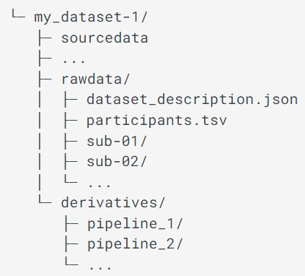
BIDS Filesystem structure
Top level directory must include
Subject directories
dataset_description.json
README
Top level directory may also include:
Directory for code
Directory for derivatives
Directory for sourcedata
Directory for stimuli
Participants file (.tsv and .json)
This file must contain a list of participant IDs, one participant per row

Slide 20
BIDS filenames
Consists of a chain of entity instances and a suffix separated by underscores, and an extension
E.g. sub-01_task-rest_bold.nii
There is a convention to the ordering of the entities

Slide 21
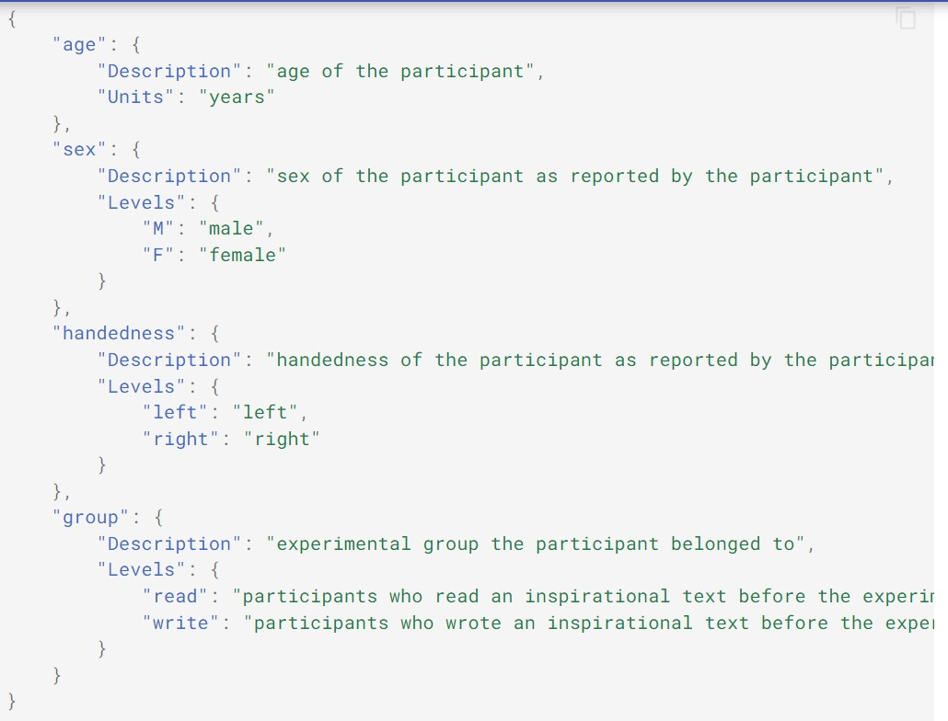
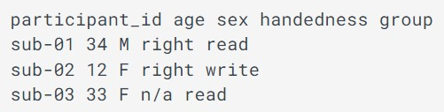
BIDS metadata
Use .tsv or .json files
The more info the better
Example of participant.json
Example of participant.tsv

Slide 22
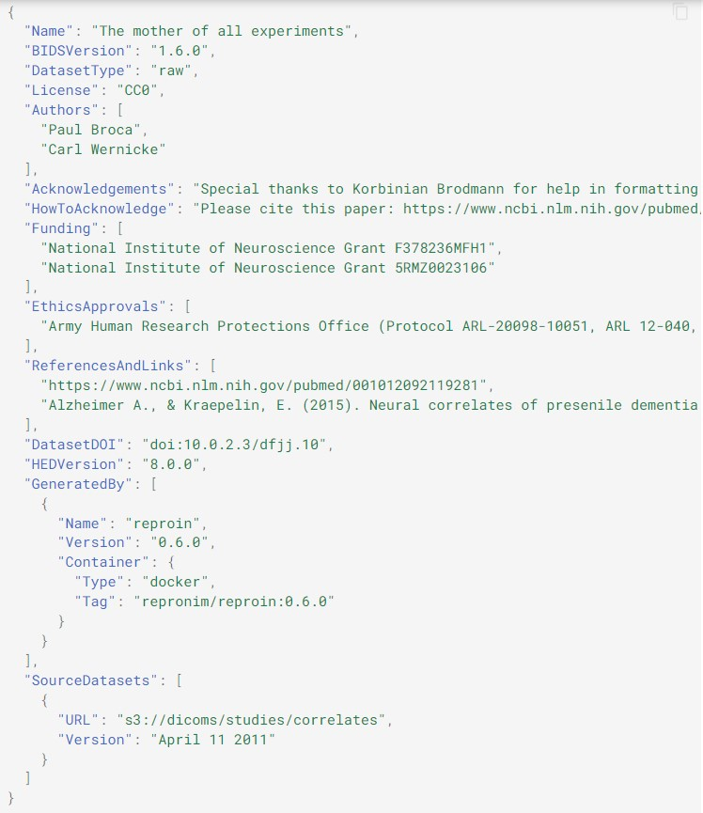
Example Dataset description file

Slide 23
BIDS derivatives
Filename should not conflict with raw files
Filename form:
<source_entities>[_keyword-<value>]_<suffix>.<ext>
If necessary to distinguish 2 files with no other differences use _desc-<label>
E.g. different pre-processing steps
Again use .json files to describe the data (including what source data was used)

Slide 24
BIDS Extension Proposals
BEP001 for qMRI
https://github.com/bids-bep001/bids-specification

Slide 25
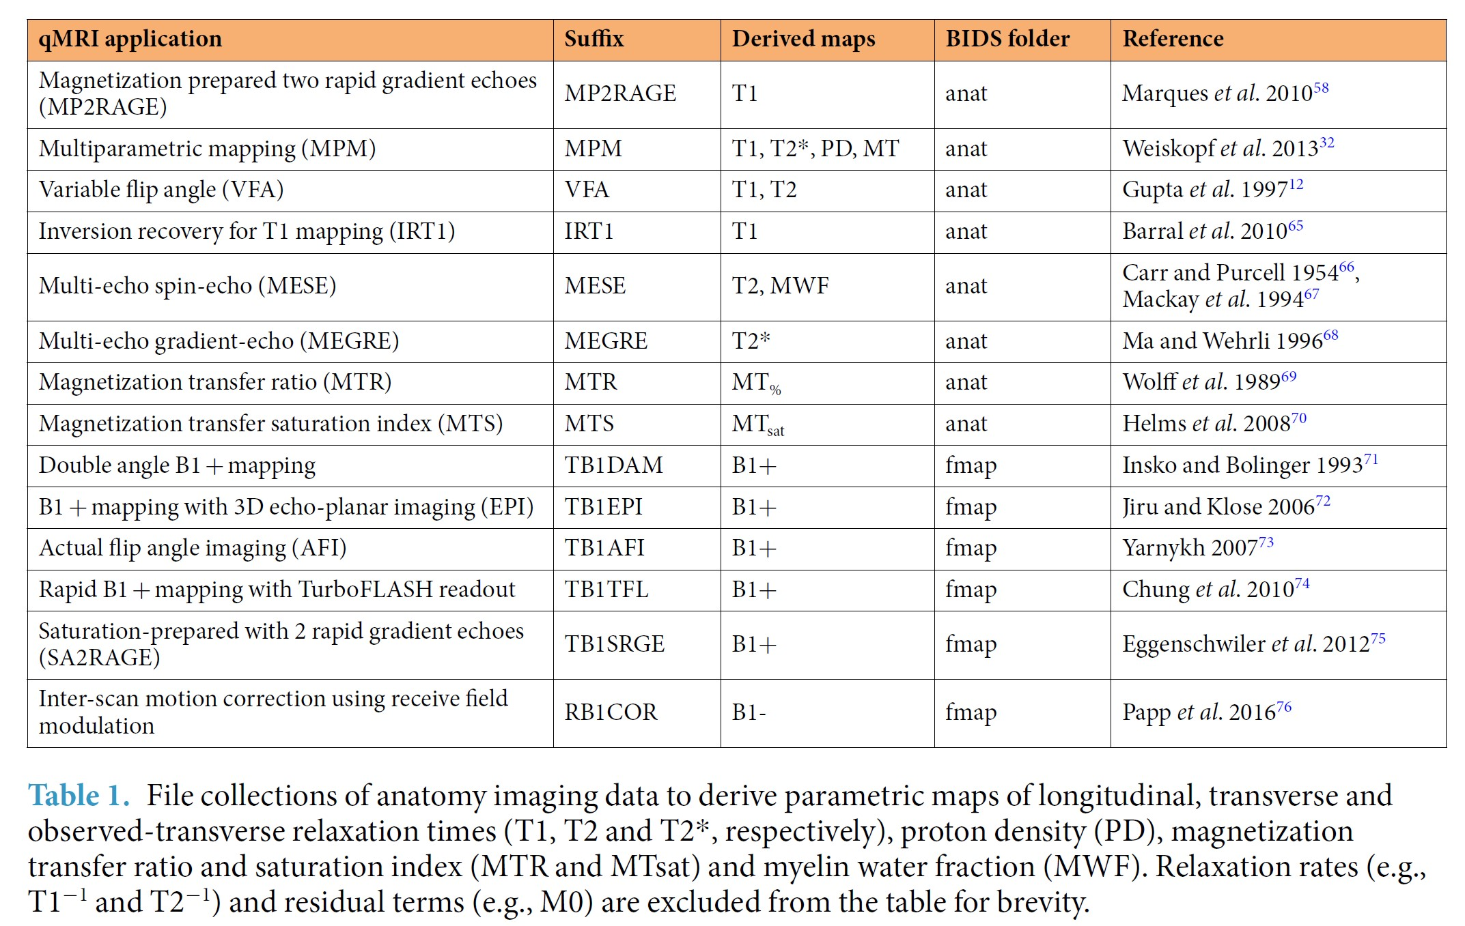
BIDS notation for qMRI

Slide 26
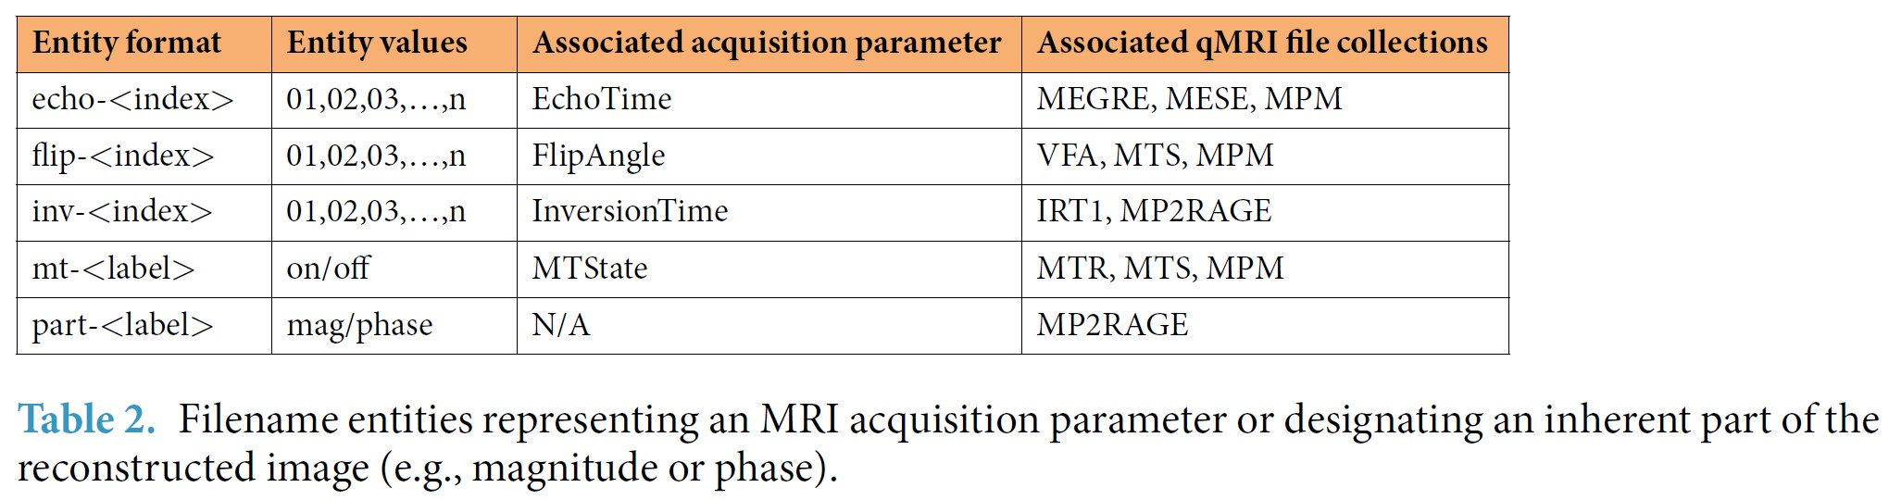
Extra BIDS filename notations

Slide 27
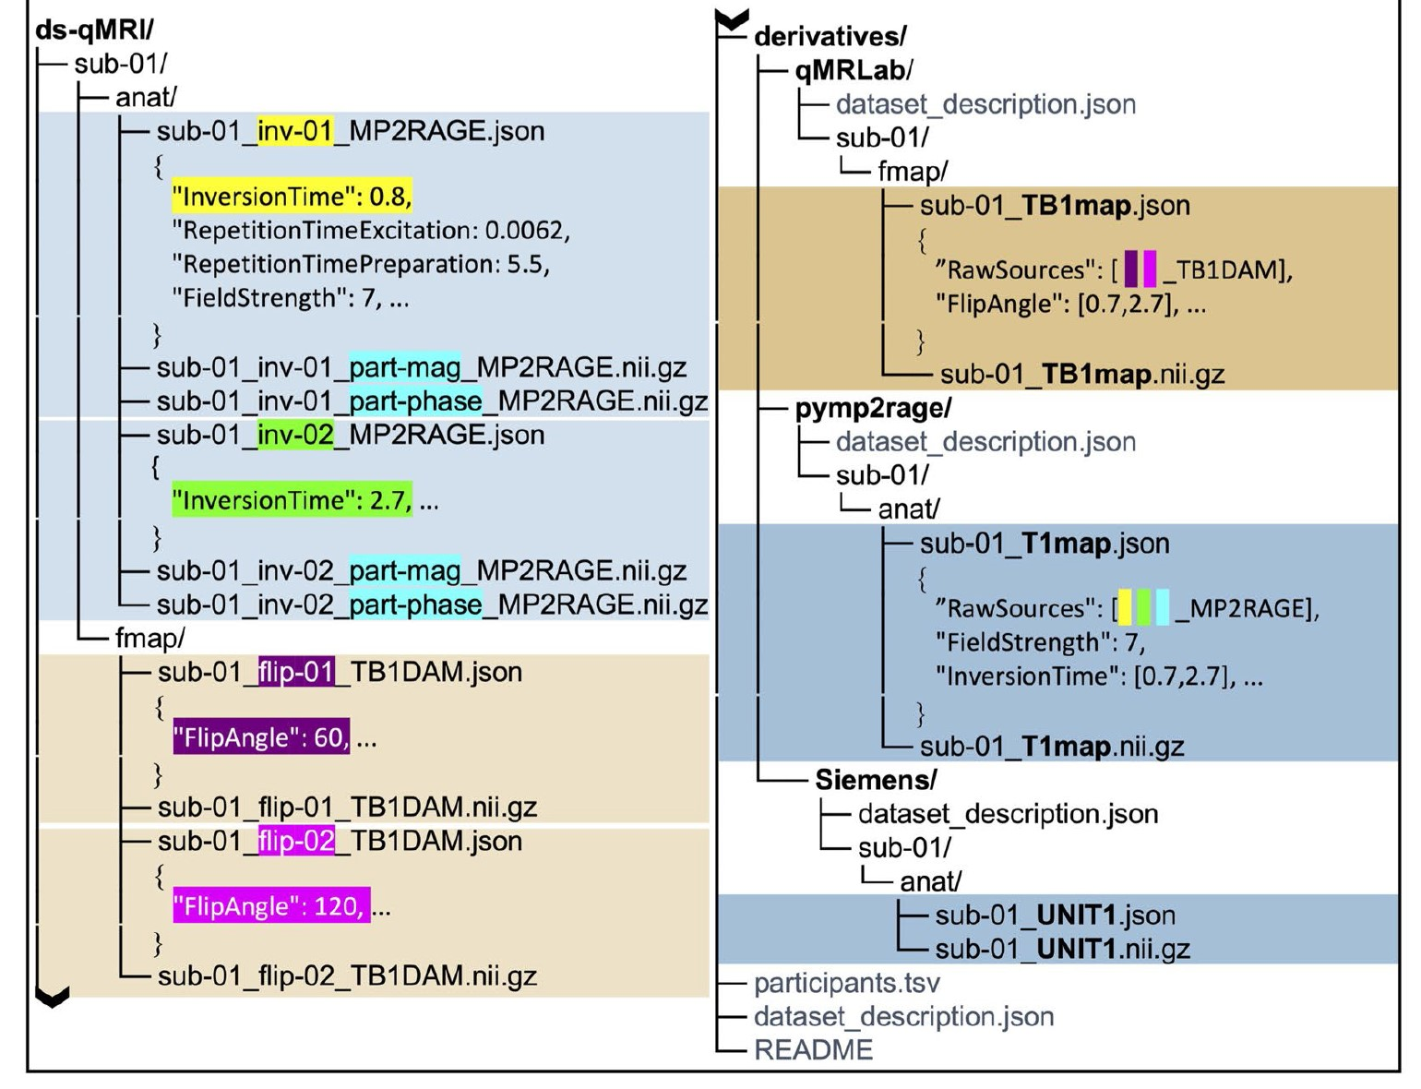
Example BIDS structure for qMRI
Raw Data
Processed Data

Slide 28
Citing BIDS (original publication)
Gorgolewski, K.J., Auer, T., Calhoun, V.D., Craddock, R.C., Das, S., Duff, E.P., Flandin, G., Ghosh, S.S., Glatard, T., Halchenko, Y.O., Handwerker, D.A., Hanke, M., Keator, D., Li, X., Michael, Z., Maumet, C., Nichols, B.N., Nichols, T.E., Pellman, J., Poline, J.-B., Rokem, A., Schaefer, G., Sochat, V., Triplett, W., Turner, J.A., Varoquaux, G., Poldrack, R.A. (2016). The brain imaging data structure, a format for organizing and describing outputs of neuroimaging experiments. Scientific Data, 3 (160044). doi:10.1038/sdata.2016.44

Slide 29
BIDS Starter Kit
Contains a collection of tutorials, wikis and templates
https://bids-standard.github.io/bids-starter-kit/

Slide 30
Next Meeting
Wednesday May 3rd
Topic:

